Slide 1
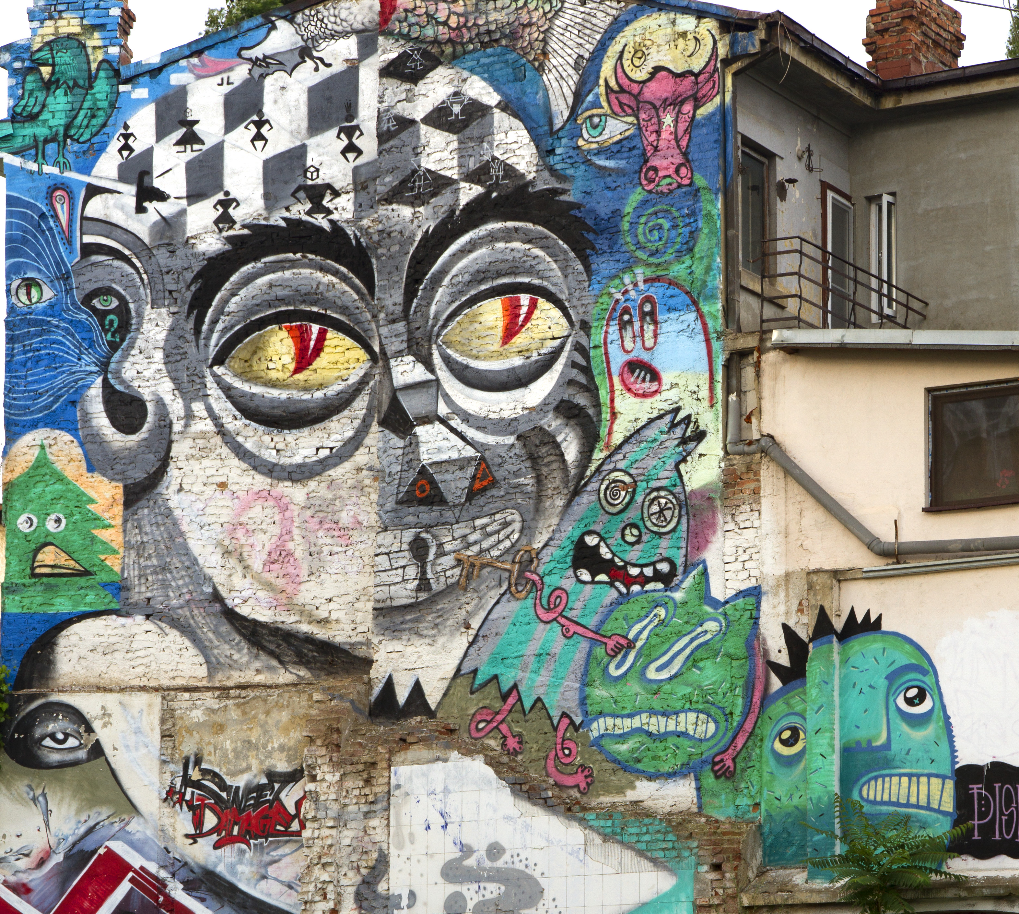
Vadim Makarov
Image: street mural in Bucharest (fragment)
© 2013 Obie Platon, Irlo, Pisica Pătrată, Last, Spesh, Lumin
Progress and challenges in quantum cryptography
Talk at Telecom ParisTech, Paris, 10 July 2015

Slide 2
Communication security you enjoy daily
Paying by credit card in a supermarket
Cell phone conversations, SMS
Email, chat, online calls
Secure browsing, shopping online
Cloud storage and communication between your devices
Software updates on your computer, phone, tablet
Online banking
Off-line banking: the bank needs to communicate internally
Electricity, water: the utility needs to communicate internally
Car keys, electronic door keys, access control
Government services (online or off-line)
Medical records at your doctor, hospital
Bypassing government surveillance and censorship
Security cameras, industrial automation, military, spies...

Slide 3
Encryption and key distribution
Alice
Bob
Secure channel
RNG
Secret key
Public (insecure) channel
Symmetric
cipher
Symmetric
cipher
Encrypted messages
Messages
Messages

Slide 4
Public key cryptography
E.g., RSA (Rivest-Shamir-Adleman)
Elliptic-curve
Based on hypothesized one-way functions
Unexpected advances in classical cryptanalysis
Shor’s factorization algorithm for quantum computer
P. W. Shor, SIAM J. Comput. 26, 1484 (1997)
Time to build large quantum computer
Re-tool infrastructure
Encryption needs be secure
What do we do here?
here?
Time
Diagram courtesy M. Mosca

Slide 5
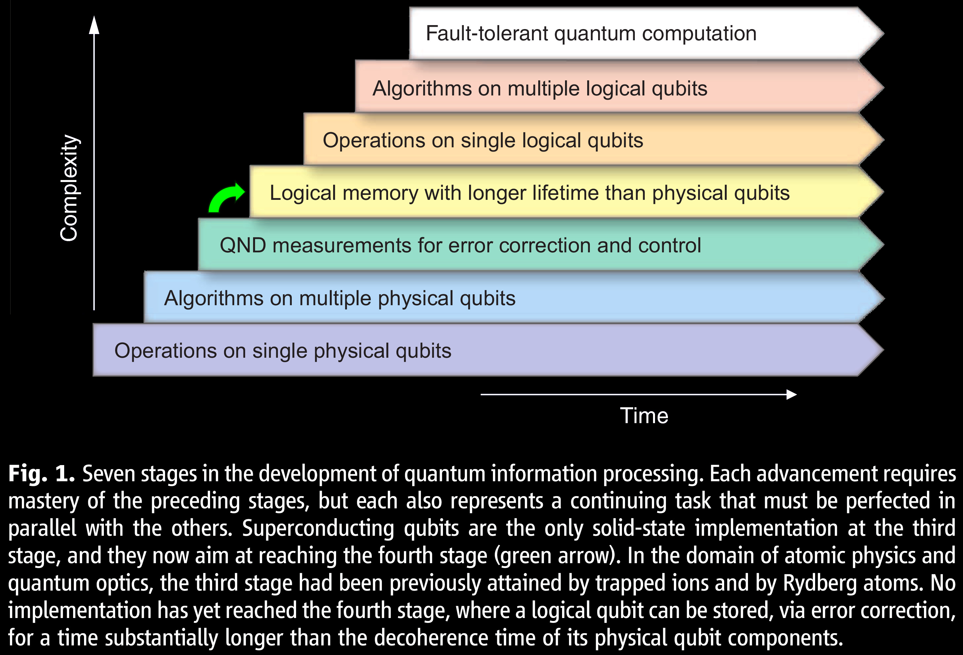
How close is quantum computer?
M. H. Devoret, R. J. Schoelkopf, “Superconducting circuits for quantum information: An outlook,”
Science 339, 1169 (2013)

Slide 6
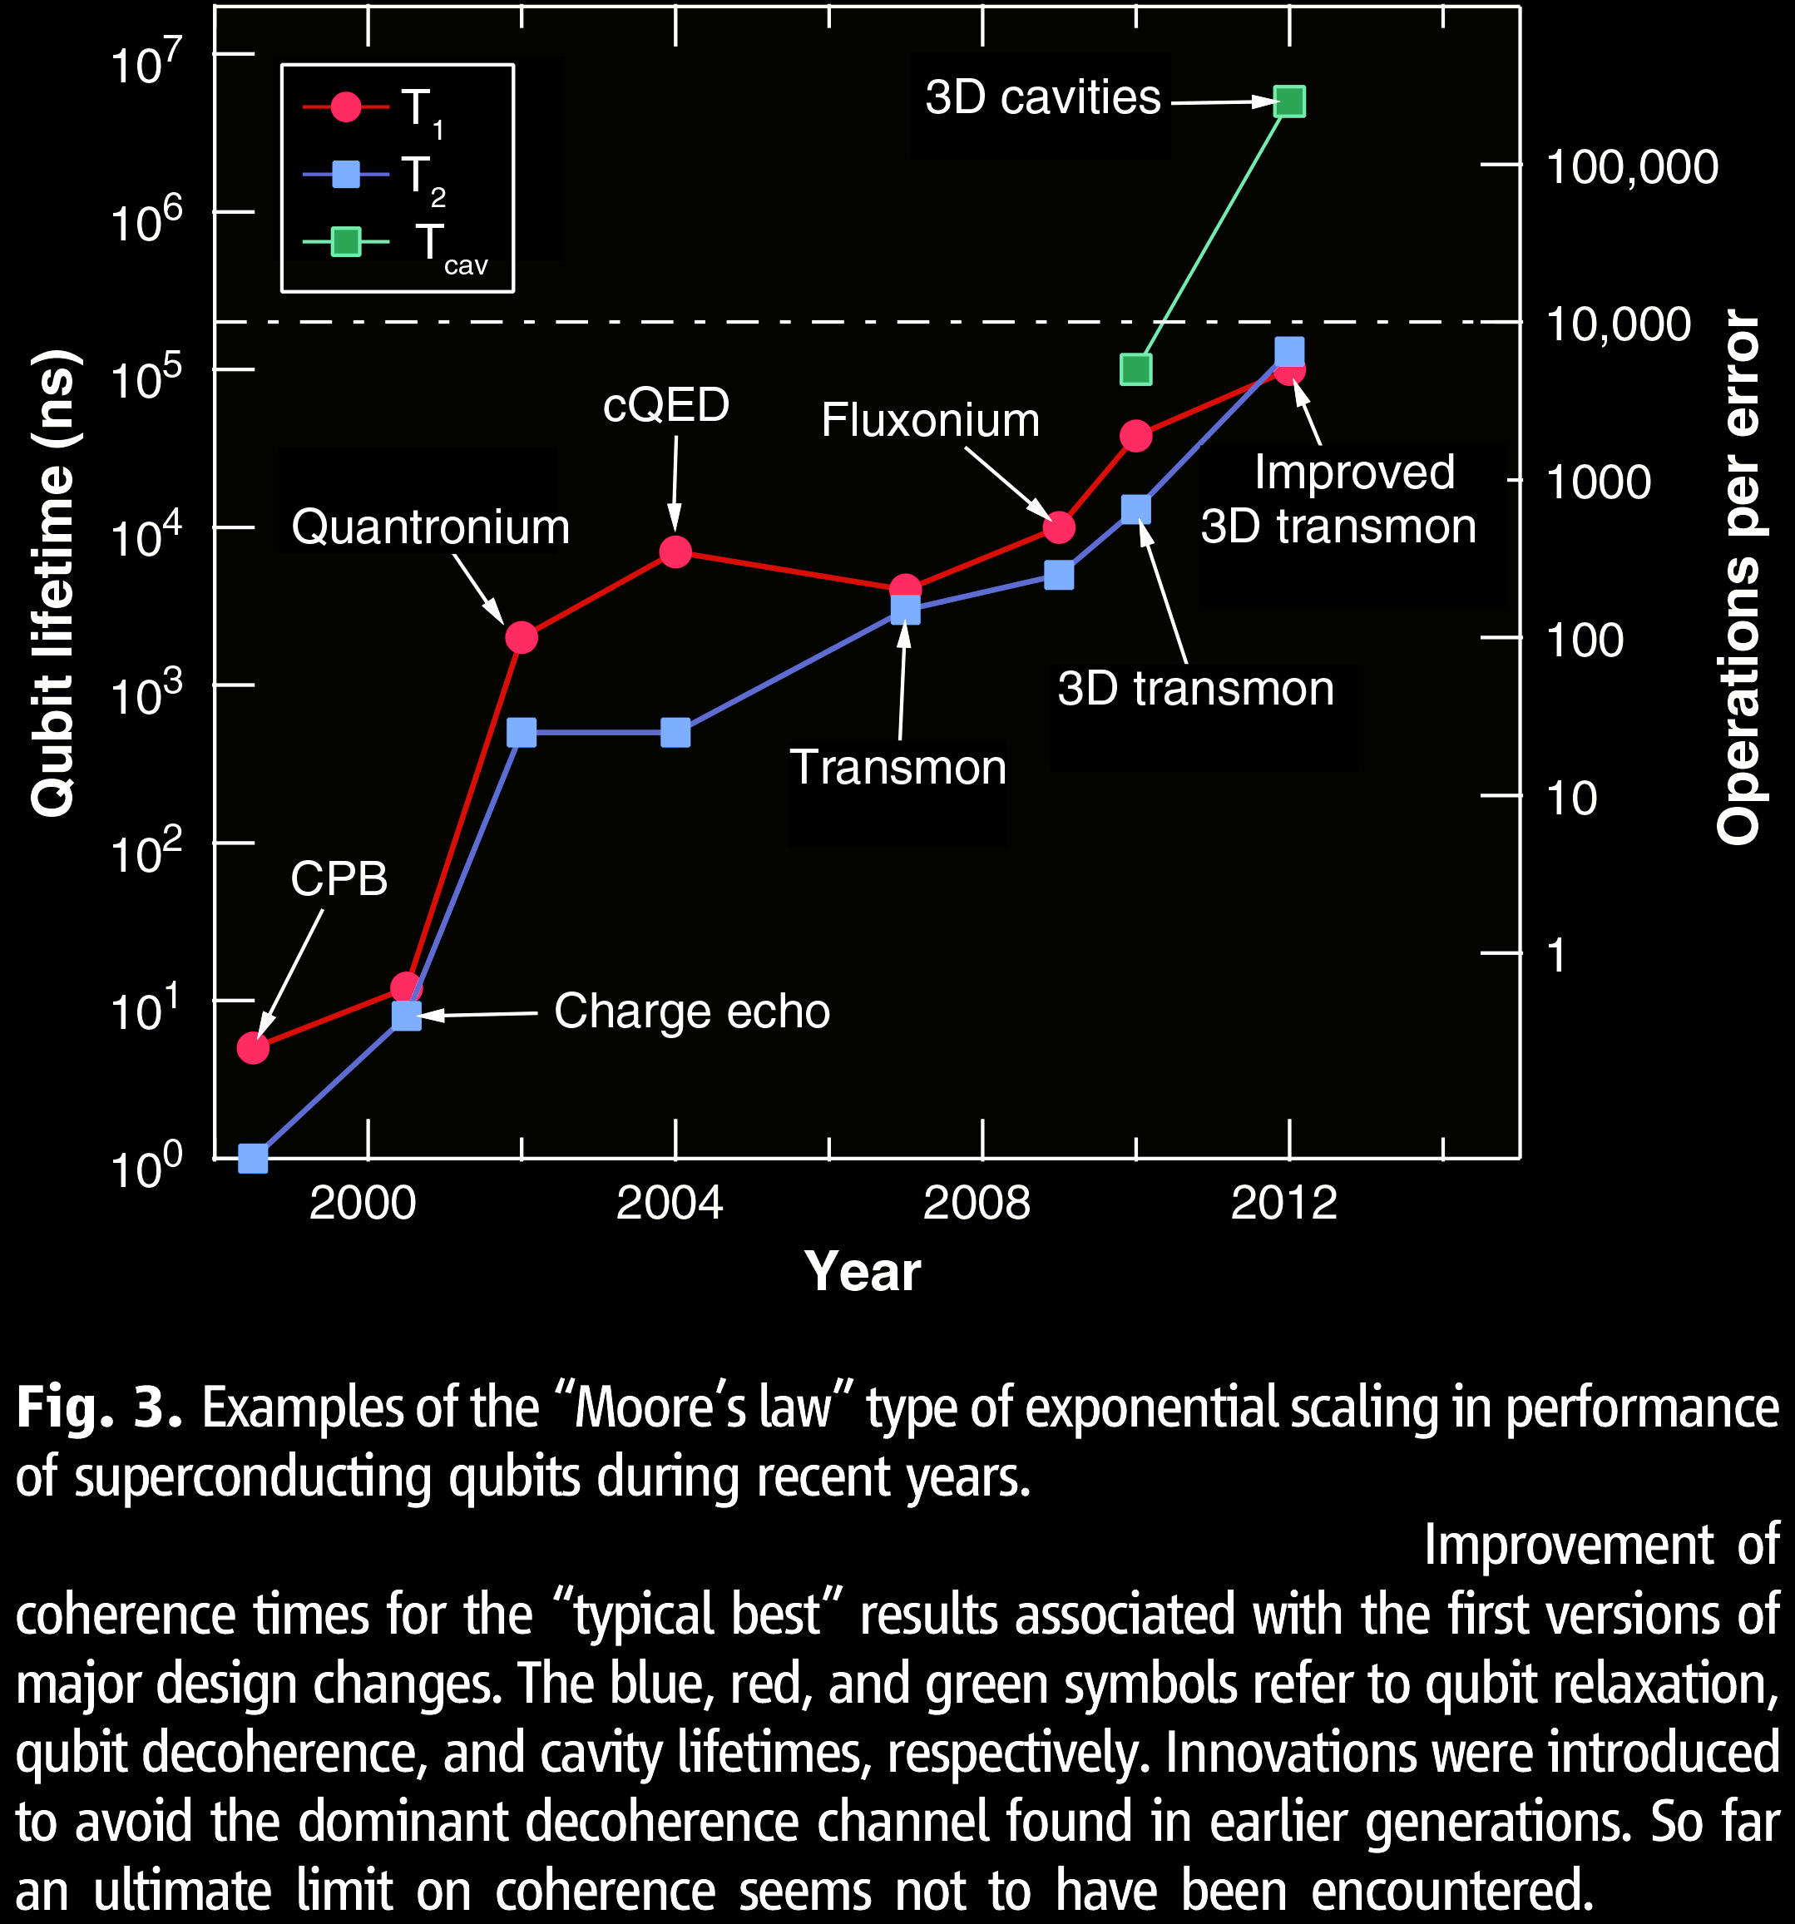
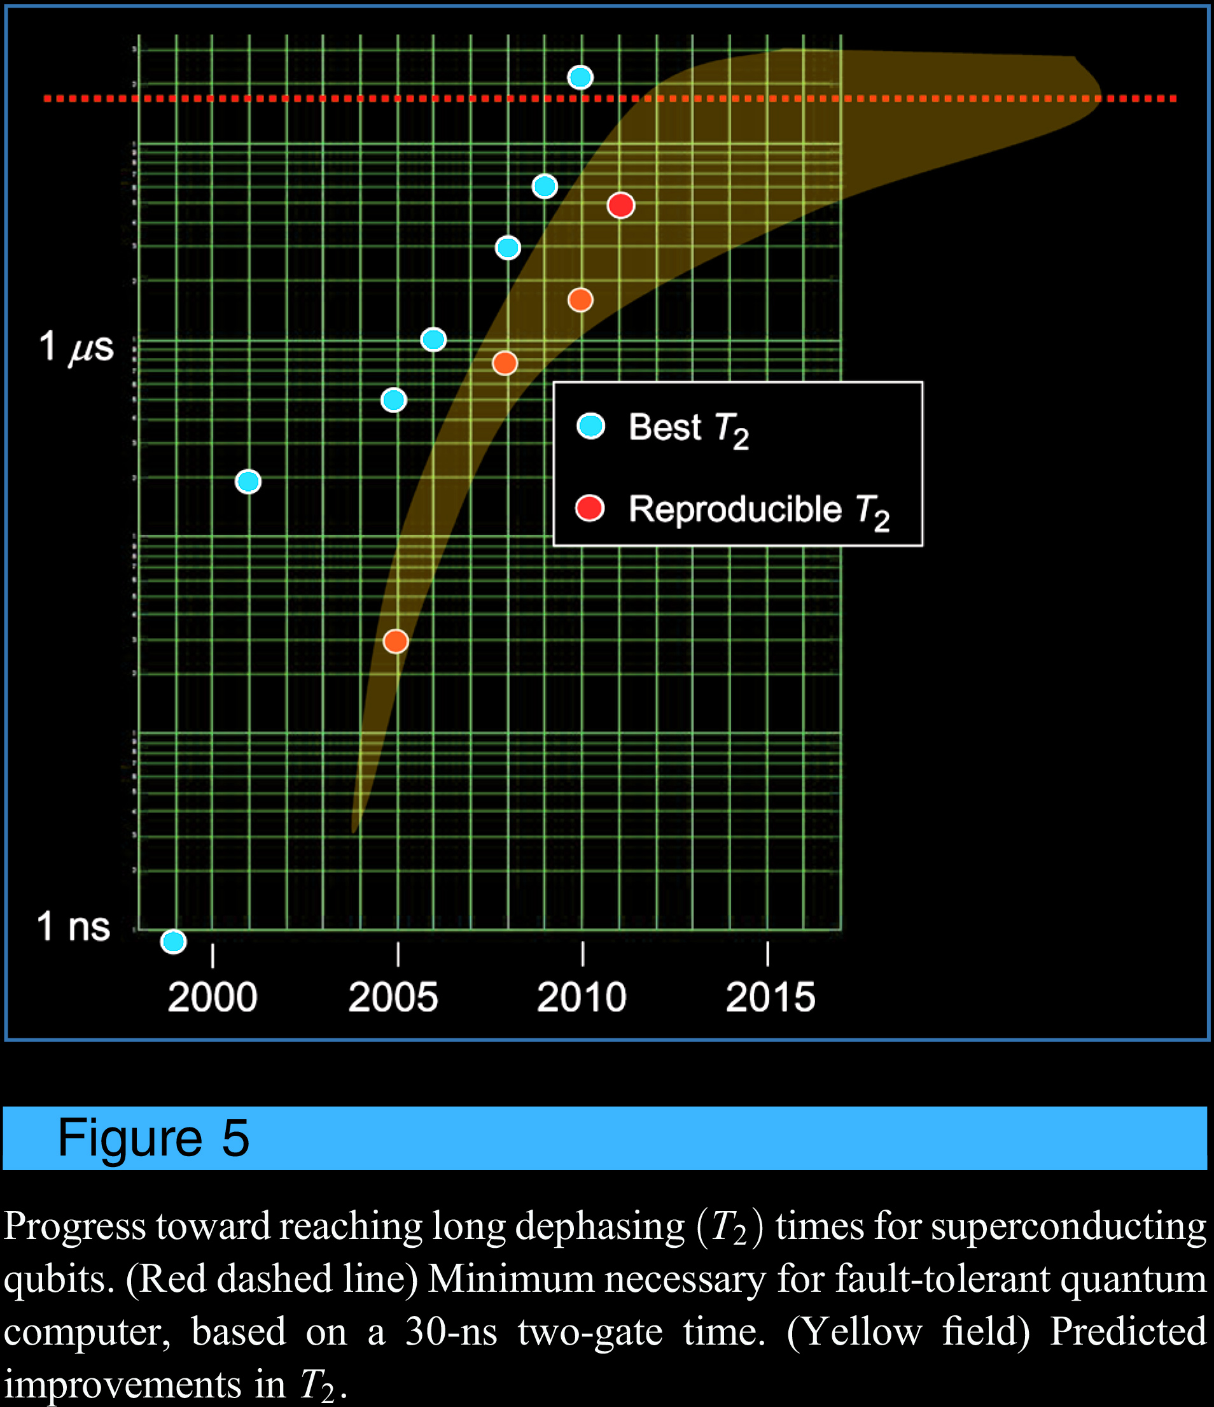
How close is quantum computer?
M. H. Devoret, R. J. Schoelkopf,
Science 339, 1169 (2013)
M. Steffen et al., “Quantum computing: An IBM perspective,” IBM J. Res. Dev. 55, 13 (2011)

Slide 7
Quantum-safe cryptographic infrastructure
Quantum computers capable of catastrophically breaking our public-key cryptography infrastructure are a medium-term threat.
+
“post-quantum” cryptography
Classical codes deployable without quantum technologies
Believed/hoped to be secure against quantum computer attacks of the future
quantum cryptography
Quantum codes requiring some quantum technologies (typically less than a large-scale quantum computer)
Typically no computational assumptions and thus known to be secure against quantum attacks
Both sets of cryptographic tools can work very well together in quantum-safe cryptographic ecosystem.
Slide courtesy M. Mosca

Slide 8
Encryption and key distribution
Alice
Bob
Secure channel
RNG
Secret key
Public (insecure) channel
Symmetric
cipher
Symmetric
cipher
Encrypted messages
Messages
Messages
Quantum key distribution transmits secret key
by sending quantum states over open channel.

Slide 9
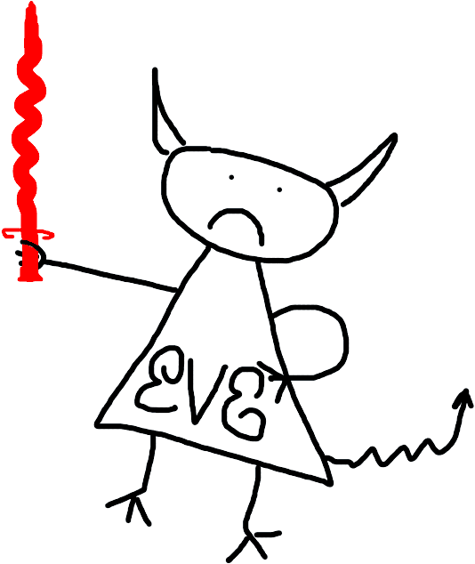
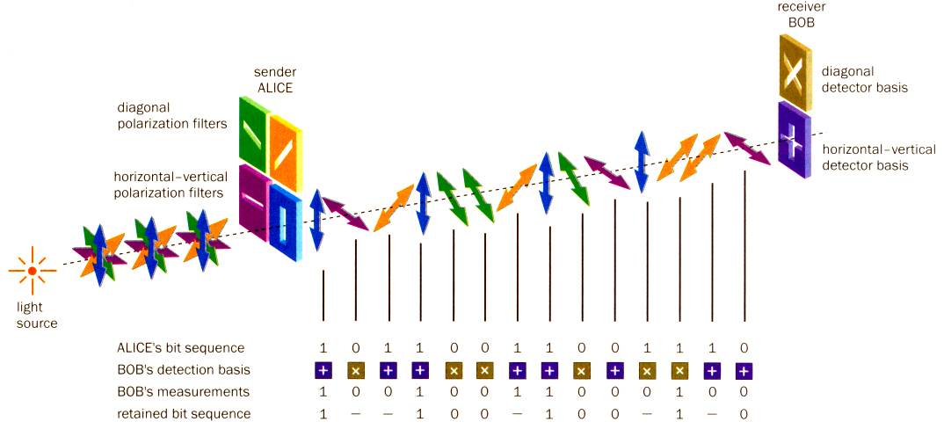
Quantum key distribution (QKD)
Bob
Alice
Diagonal detector basis
Diagonal polarization filters
0
1
Horizontal-vertical detector basis
Horizontal-vertical polarization filters
0
1
Light source
Alice’s bit sequence 1 0 1 1 0 0 1 1 0 0 1 1 1 0
Bob’s detection basis
Bob’s measurement 1 0 0 1 0 0 1 1 0 0 0 1 0 0
Retained bit sequence 1 – – 1 0 0 – 1 0 0 – 1 – 0
Image reprinted from article: W. Tittel, G. Ribordy & N. Gisin, “Quantum cryptography,” Physics World, March 1998

Slide 10
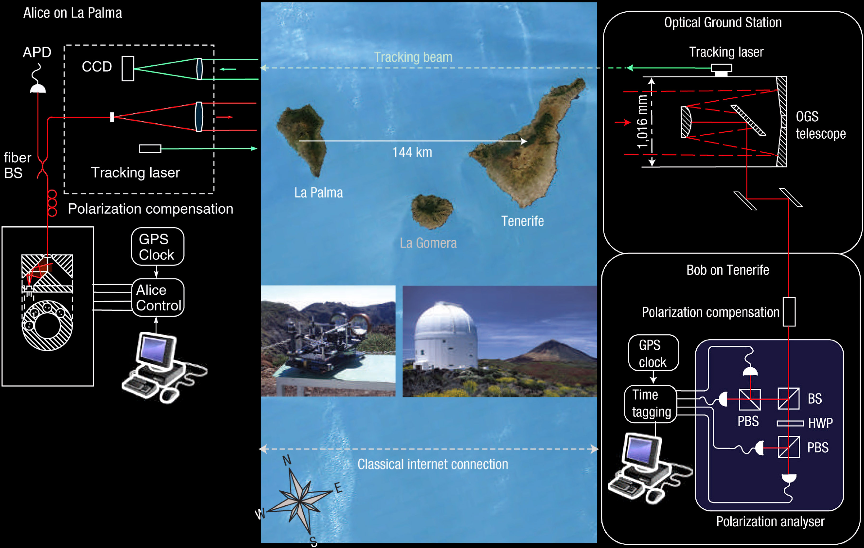
Free-space QKD over 144 km
T. Schmitt-Manderbach et al., Phys. Rev. Lett. 98, 010504 (2007)

Slide 11
Phase encoding, interferometric QKD channel
Alice
Bob
Light
source
long
short
ϕ
D
0
B
ϕ
D
A
short
Transmission line
long
1
Detector bases:
ϕ_{B} = – 45° : X
ϕ_{B} = + 45° : Z
ϕ_{A} = – 45° or + 45° : 0
ϕ_{A} = +135° or – 135° : 1

Slide 12
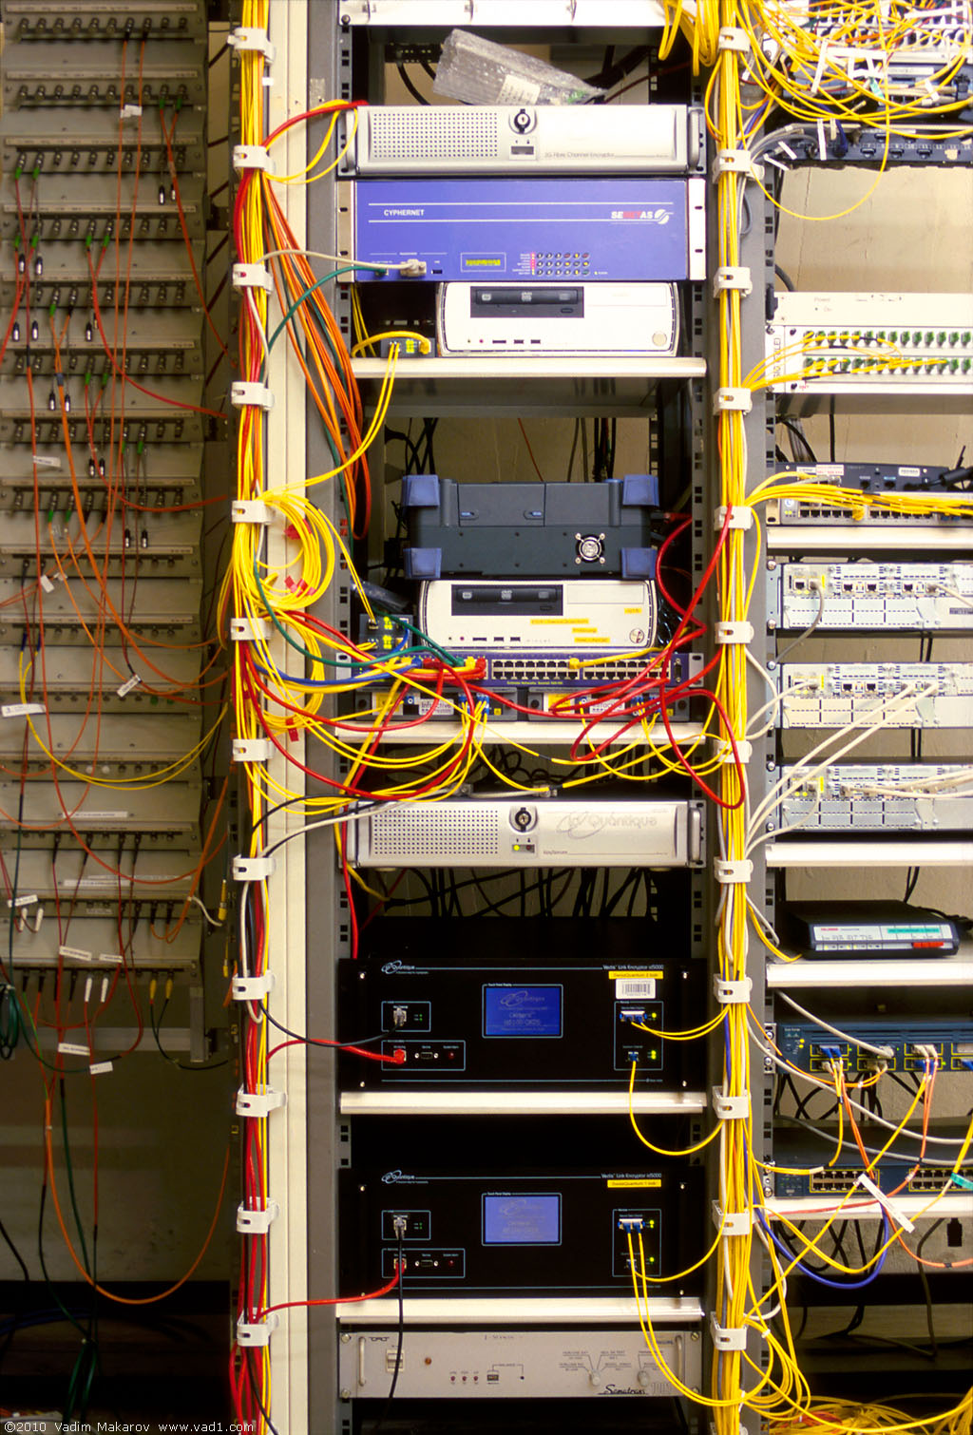
Commercial QKD
Classical encryptors:
L2, 2 Gbit/s
L2, 10 Gbit/s
L3 VPN, 100 Mbit/s
WDMs
17 km (fiber length)
Key manager
14 km
QKD to another node
(4 km)
QKD to another node
(14 km)
4 km
Photo © 2010 Vadim Makarov
www.swissquantum.com
ID Quantique Cerberis system (2010)

Slide 13
Trusted-node repeater
User
Trusted node
User
QKD 1
QKD 2
K1
K1
K2
K2
K1⊕K2
K1
K1⊕K2⊕K2 = K1

Slide 14
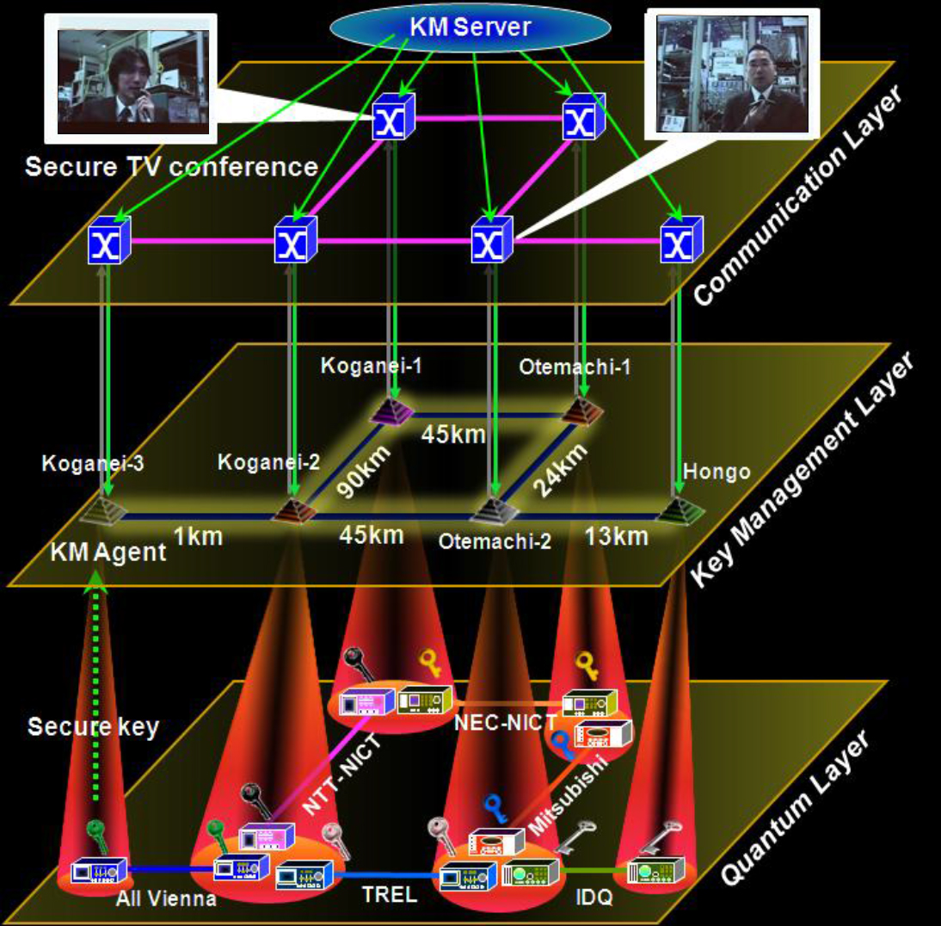
Trusted-node network
M. Sasaki et al., Opt. Express 19, 10387 (2011)

Slide 15
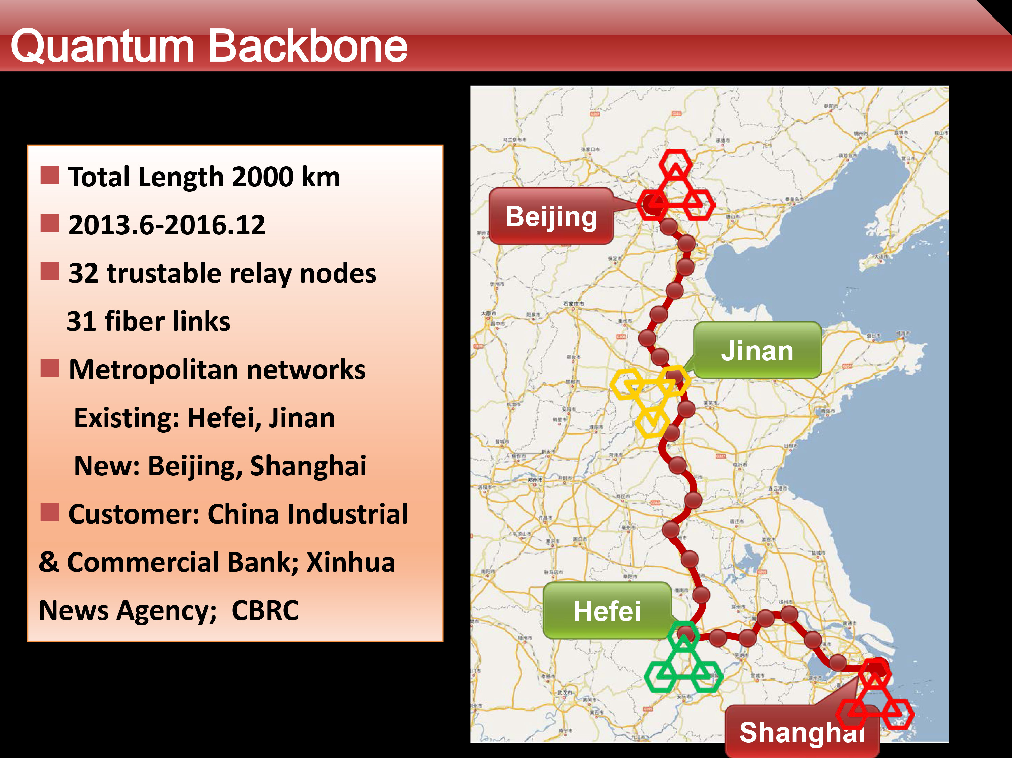
Q. Zhang, talk at QCrypt 2014

Slide 16
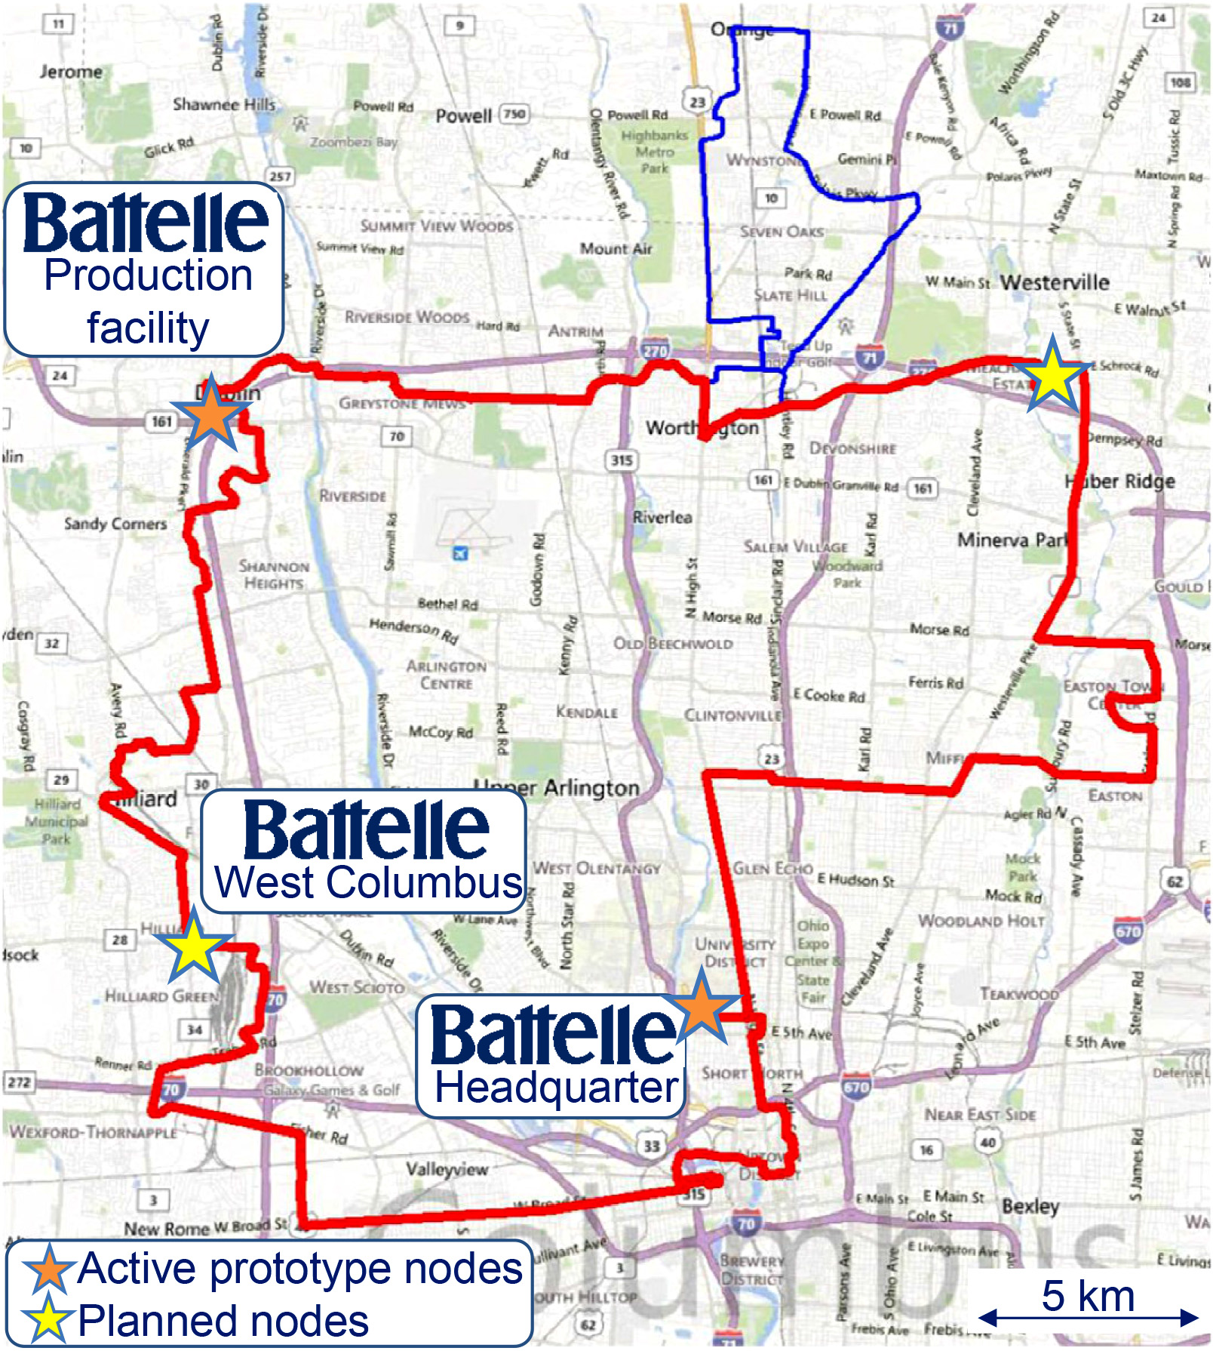
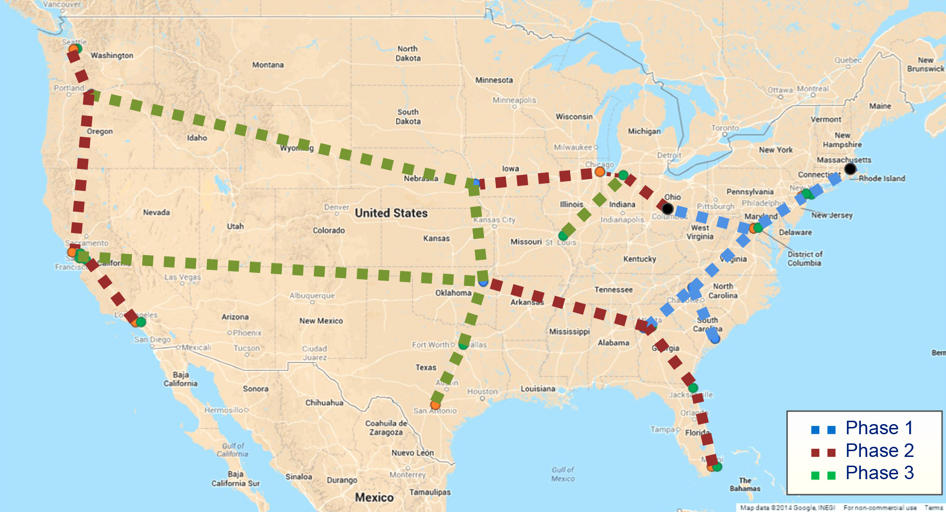
The Battelle quantum network
Plans:
N. Walenta et al., poster at QCrypt 2014

Slide 17
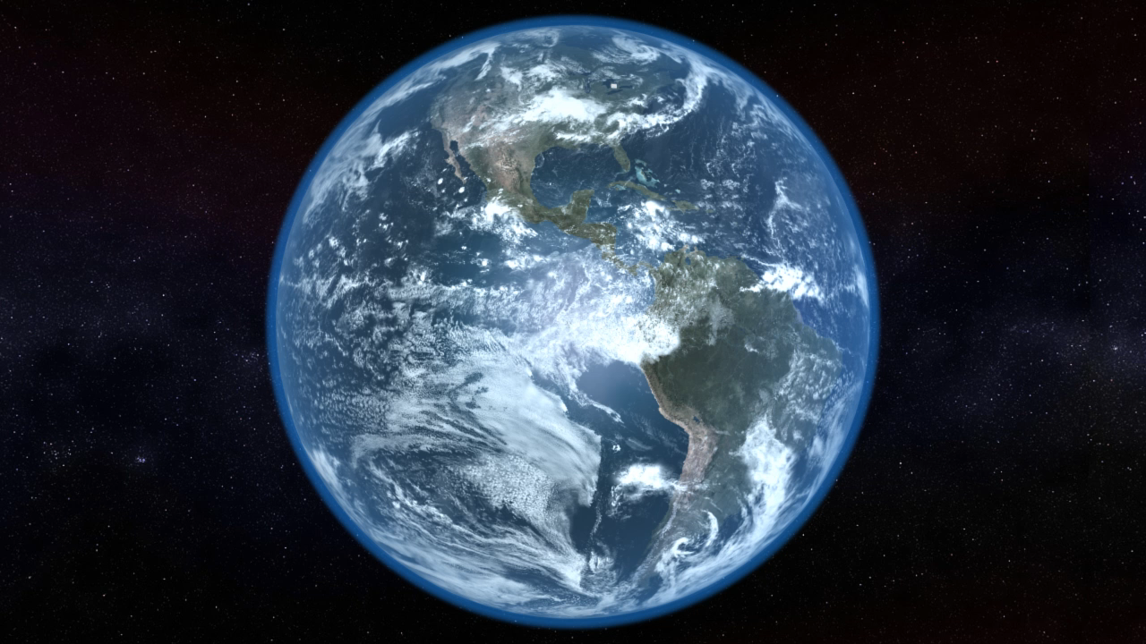
Video ©2012 IQC / group of T. Jennewein

Slide 18
Dual key agreement
QKD
BB84
QKD
PKI
RSA-2048
PKI
Key
Key
Symmetric
cipher
AES-256
Symmetric
cipher
Certified
Photo © 2010 Vadim Makarov
www.swissquantum.com
ID Quantique Cerberis system (2010)

Slide 19
Cryptography: classical vs. quantum
Unproven mathematical assumptions
Laws of
physics
Based on...
Convenient to implement?
Yes
No
Forward secure?
No
Yes
Authenticate via PKI?
Yes
Yes
Loopholes in implementations?
Yes
Yes
Exploitable retroactively?
Sometimes
No*
* Single exception: A. Lamas-Linares & C. Kurtsiefer, Opt. Express 15, 9388 (2007)

Slide 20
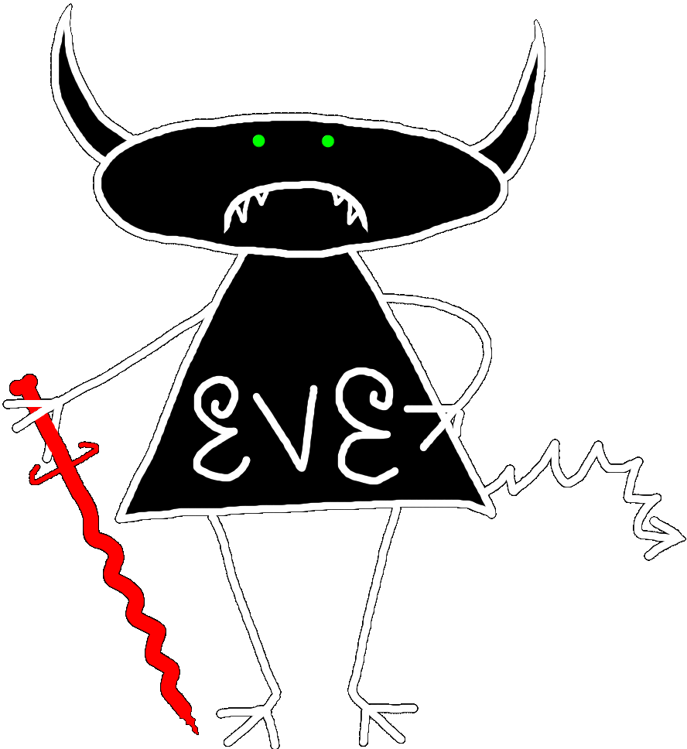


Security model of QKD
Alice
Bob
1
Secret key rate $R=f\left(\text{QBER}\right)$
R
0
0
0.11
QBER
Security proof
.Laws of physics & Model of equipment

Slide 21
Security model of QKD
Security proof
.Laws of physics & Model of equipment
Integrate imperfection into security model
Hack
Security proof
.Laws of physics & Model of equipment

Slide 22
Attack | Target component | Tested system
Spatial efficiency mismatch | receiver optics | research system
M Rau et al., IEEE J. Quantum Electron. 21, 6600905 (2015); S. Sajeed et al., Phys. Rev. A 91, 062301 (2015)
Pulse energy calibration | classical watchdog detector | ID Quantique
S. Sajeed et al., Phys. Rev. A 91, 032326 (2015)
Trojan-horse | phase modulator in Alice | SeQureNet
I. Khan et al., presentation at QCrypt (2014)
Trojan-horse | phase modulator in Bob | ID Quantique*
N. Jain et al., New J. Phys. 16, 123030 (2014)
Detector saturation | homodyne detector | SeQureNet
H. Qin, R. Kumar, R. Alleaume, Proc. SPIE 88990N (2013)
Shot-noise calibration | classical sync detector | SeQureNet
P. Jouguet, S. Kunz-Jacques, E. Diamanti, Phys. Rev. A 87, 062313 (2013)
Wavelength-selected PNS | intensity modulator | (theory)
M.-S. Jiang, S.-H. Sun, C.-Y. Li, L.-M. Liang, Phys. Rev. A 86, 032310 (2012)
Multi-wavelength | beamsplitter | research system
H.-W. Li et al., Phys. Rev. A 84, 062308 (2011)
Deadtime | single-photon detector | research system
H. Weier et al., New J. Phys. 13, 073024 (2011)
Channel calibration | single-photon detector | ID Quantique
N. Jain et al., Phys. Rev. Lett. 107, 110501 (2011)
Faraday-mirror | Faraday mirror | (theory)
S.-H. Sun, M.-S. Jiang, L.-M. Liang, Phys. Rev. A 83, 062331 (2011)
Detector control | single-photon detector | ID Quantique, MagiQ, research system
I. Gerhardt et al., Nat. Commun. 2, 349 (2011); L. Lydersen et al., Nat. Photonics 4, 686 (2010)
Phase-remapping | phase modulator in Alice | ID Quantique*
F. Xu, B. Qi, H.-K. Lo, New J. Phys. 12, 113026 (2010)
* Attack did not break security of the tested system, but may be applicable to a different implementation.

Slide 23
Example 1: academic
Photon-number-splitting attack
C. Bennett, F. Bessette, G. Brassard, L. Salvail, J. Smolin, J. Cryptology 5, 3 (1992)
G. Brassard, N. Lütkenhaus, T. Mor, B. C. Sanders, Phys. Rev. Lett. 85, 1330 (2000)
N. Lütkenhaus, Phys. Rev. A 61, 052304 (2000)
S. Félix, N. Gisin, A. Stefanov, H. Zbinden, J. Mod. Opt. 48, 2009 (2001)
N. Lütkenhaus, M. Jahma, New J. Phys. 4, 44 (2002)
Decoy-state protocol
W.-Y. Hwang, Phys. Rev. Lett. 91, 057901 (2003)
SARG04 protocol
V. Scarani, A. Acín, G. Ribordy, N. Gisin, Phys. Rev. Lett. 92, 057901 (2004)
Distributed-phase-reference protocols
K. Inoue, E. Waks, Y. Yamamoto, Phys. Rev. Lett. 89, 037902 (2002)
K. Inoue, E. Waks, Y. Yamamoto, Phys. Rev. A. 68, 022317 (2003)
N. Gisin, G. Ribordy, H. Zbinden, D. Stucki, N. Brunner, V. Scarani, arXiv:quant-ph/0411022v1 (2004)
Laser
Attenuator

Slide 24
Example 2: industrial (ID Quantique)
2004-11-10
First commercial Clavis1 system is shipped to a customer
2009-10-22
Report about detector blinding attack sent to company
2010-10-08
Company applies for a patent on randomization
of detector efficiency as a countermeasure
Lim et al. preprint about the countermeasure arXiv:1408.6398
2014-08-27
Implementation of countermeasure delivered by company
to our lab (firmware update for Clavis2)
2014-11-18
2015-04-17
Countermeasure testing report sent to company
A. Huang et al., unpublished

Slide 25
Randomly varying detector sensitivity
(ID Quantique)
V_{APD}
Click
Click
V_{APD}
Click
Click
Alarm!
C. C. W. Lim et al., arXiv:1408.6398
M. Legre, G. Robordy, Intl. patent appl. WO 2012/046135 A2 (filed in 2010)

Slide 26
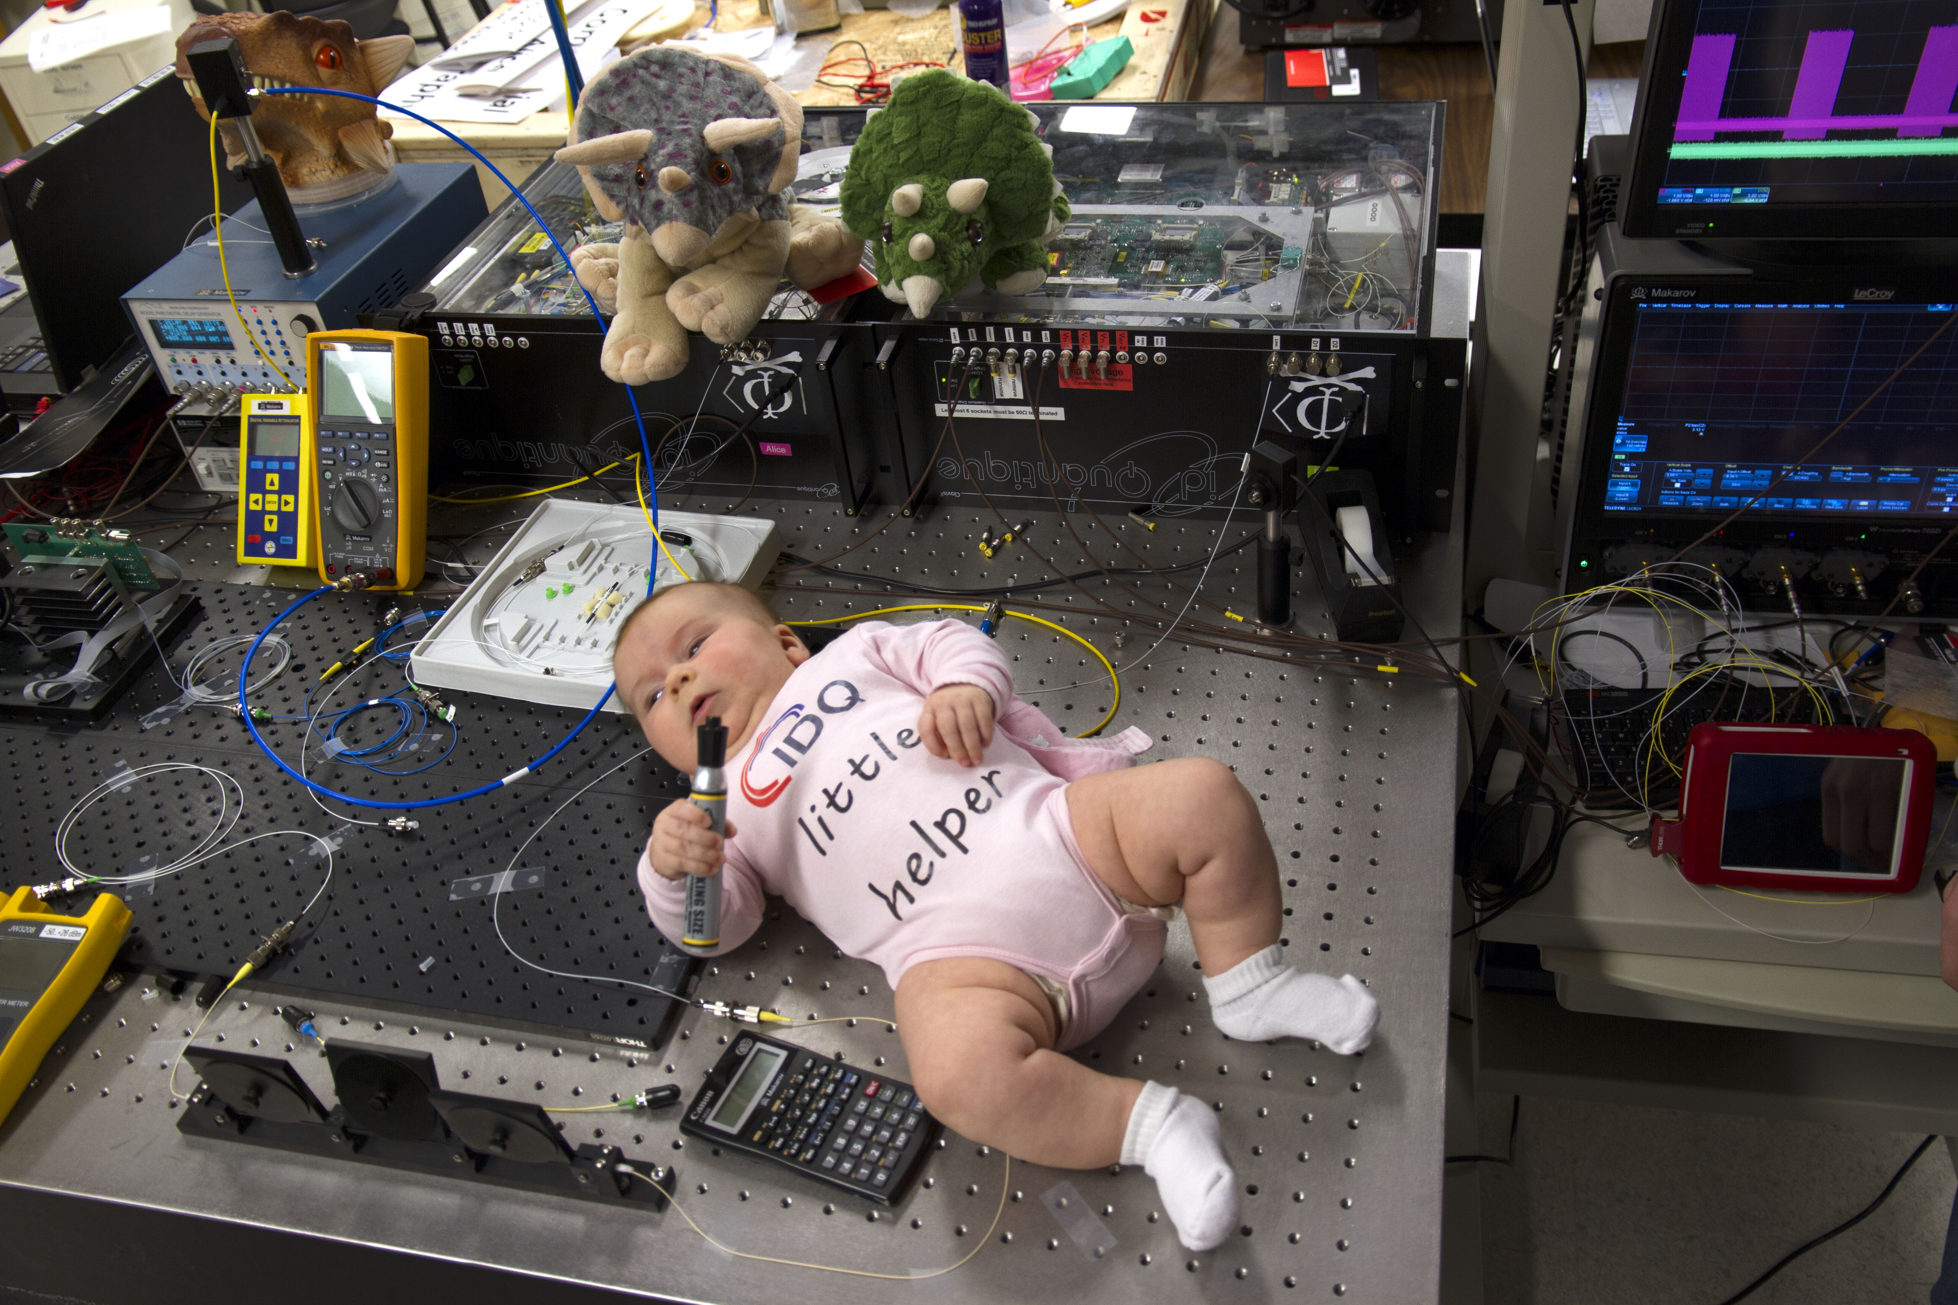
Photo © 2015 Vadim Makarov

Slide 27
Example 3: academic. Efficiency mismatch
C.-H. F. fung et al., Quantum Inf. Comput. 9, 0131 (2009)

Slide 28
Efficiency mismatch in QKD receiver
S. Sajeed et al., Phys. Rev. A 91, 062301 (2015).

Slide 29
Detector efficiency without pinhole
...and with 25 μm
diameter pinhole
S. Sajeed et al., Phys. Rev. A 91, 062301 (2015).

Slide 30
Security model of QKD
Security proof
.Laws of physics & Model of equipment
Integrate imperfection into security model
Hack

Slide 31
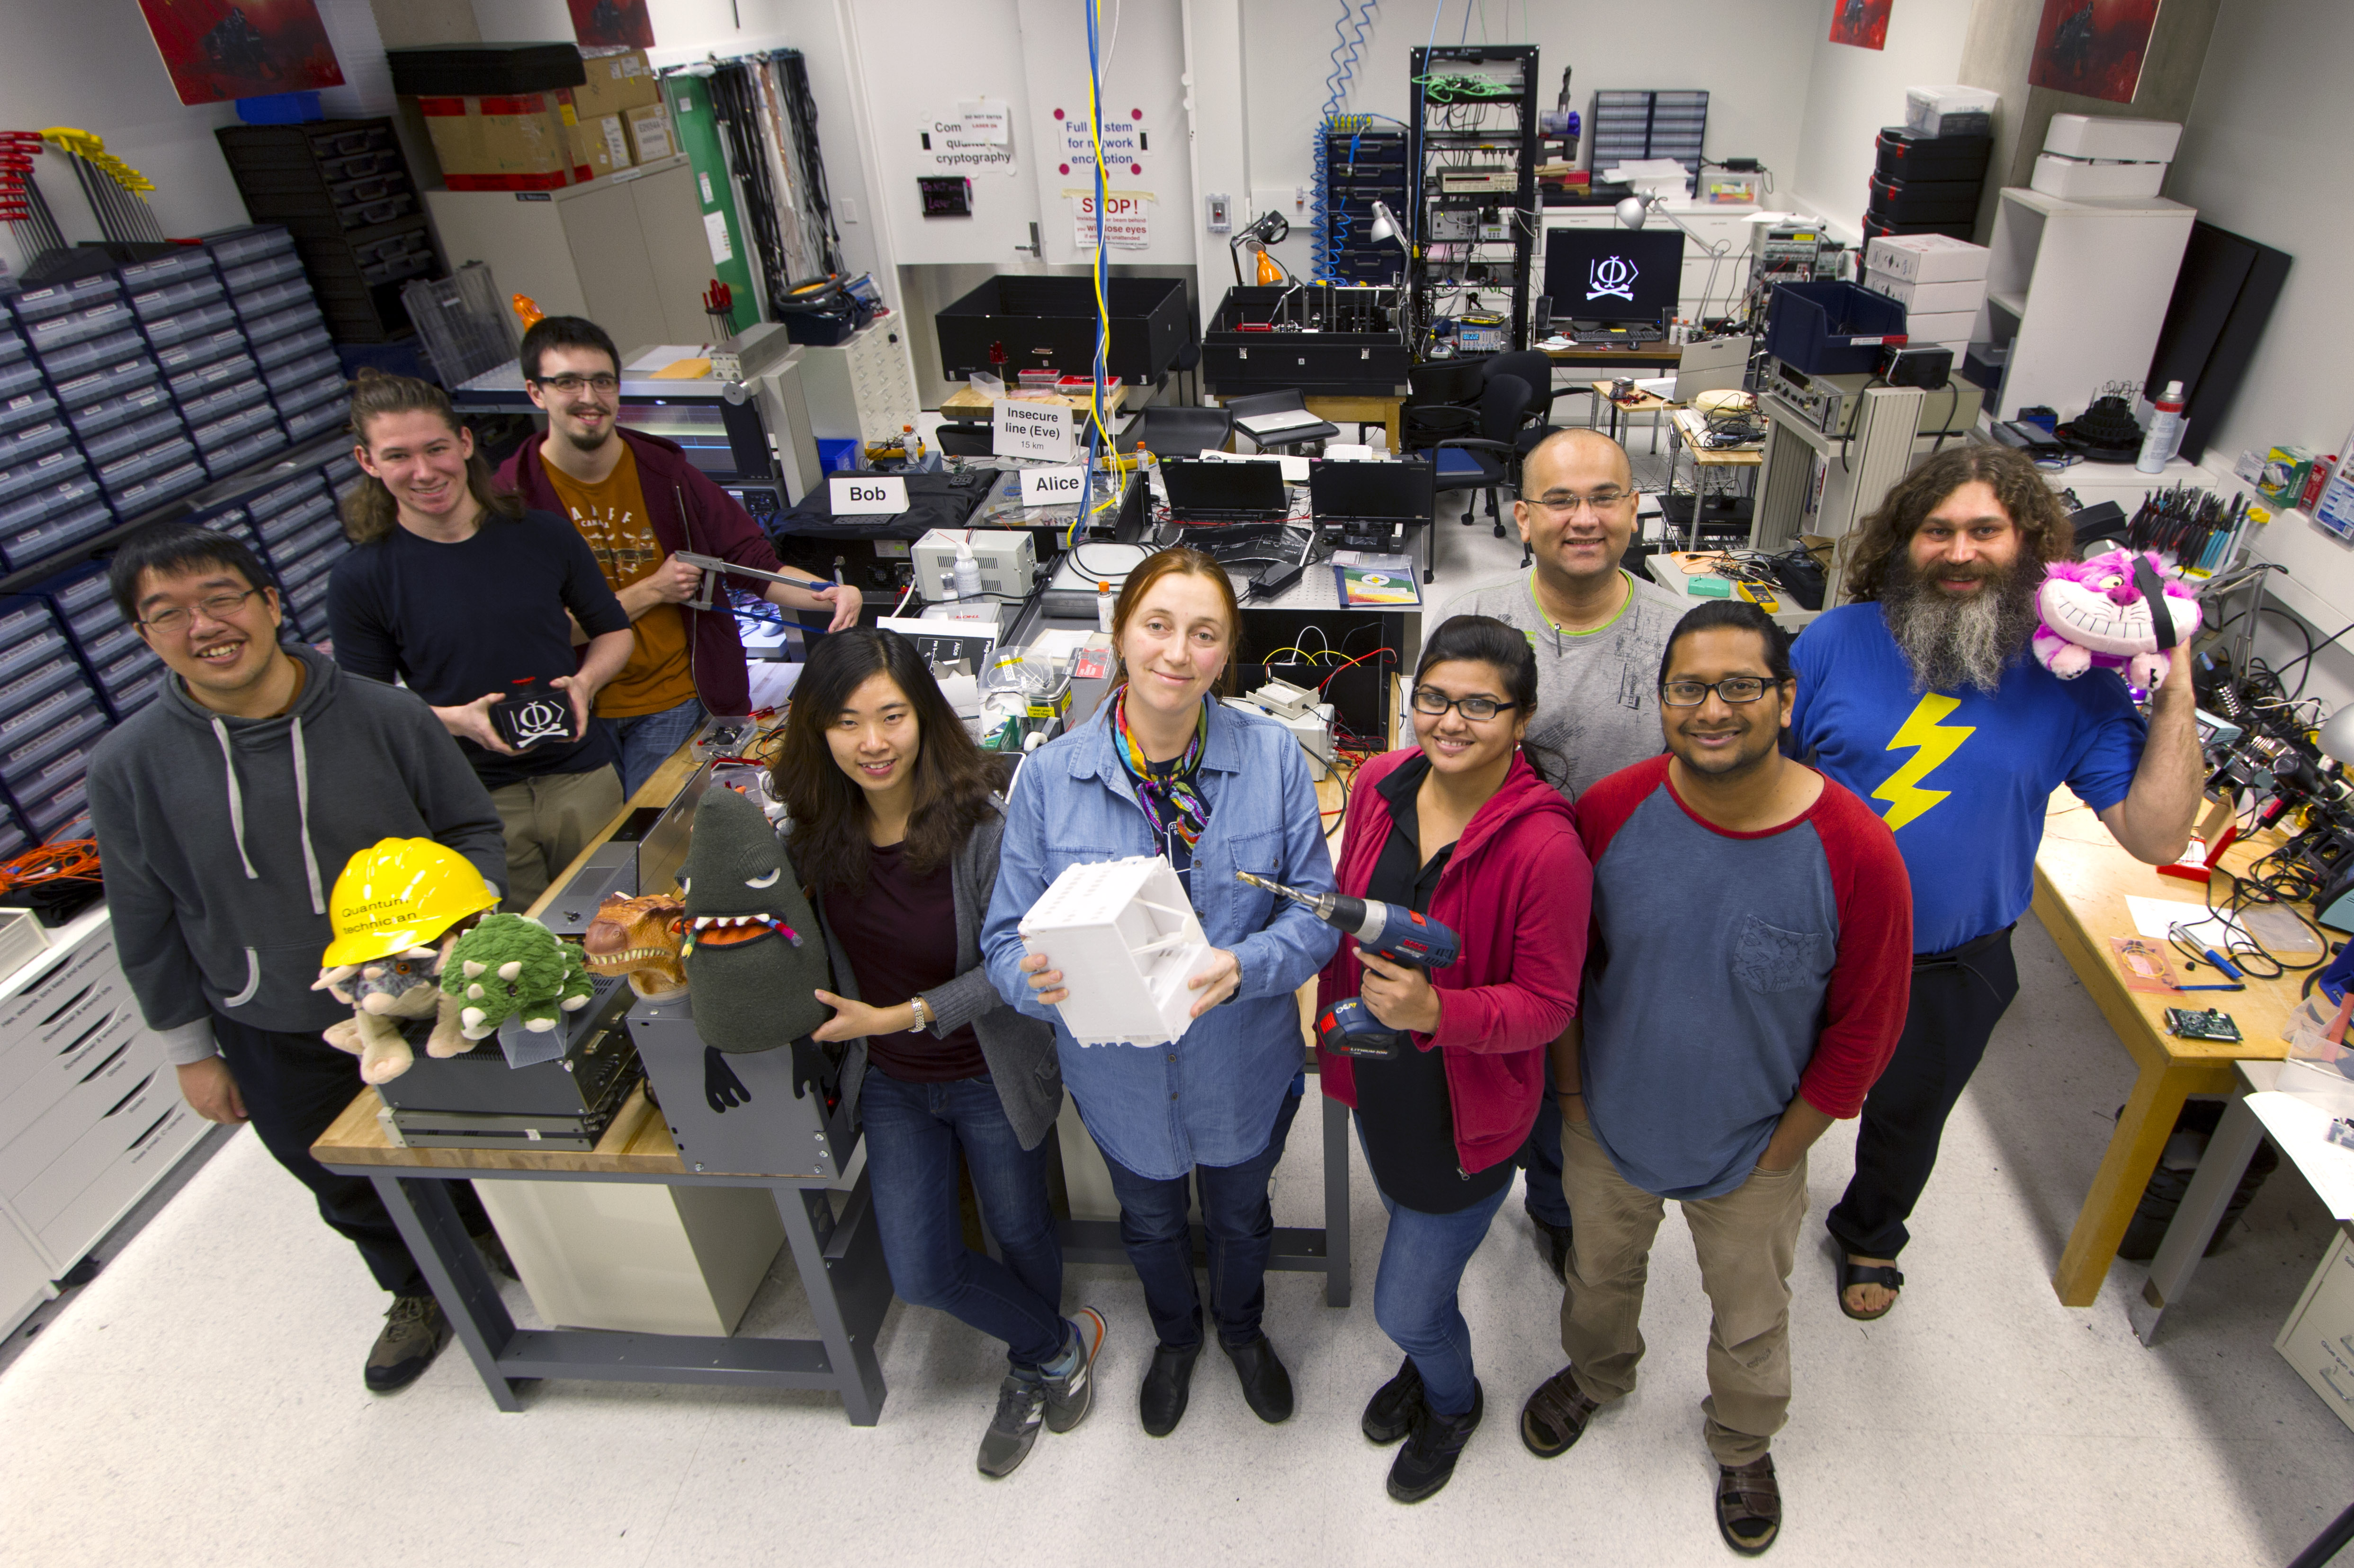
Photo © 2014 Vadim Makarov, Scott McManus / IQC
Quantum hacking lab www.vad1.com/lab

Slide 32

Quantum hacking lab www.vad1.com/lab

